Slide 1

Action Recognition with Mediapipe and TensorFlow

Slide 2
Project Objectives and Functionality
Objectives
Functionality
Extract keypoints from video frames using Mediapipe.
Data collection and preprocessing.
Train a neural network to classify actions based on keypoints.
Action classification using a trained model.
Real-time predictions with visual feedback.
Enable real-time action recognition.

Slide 3
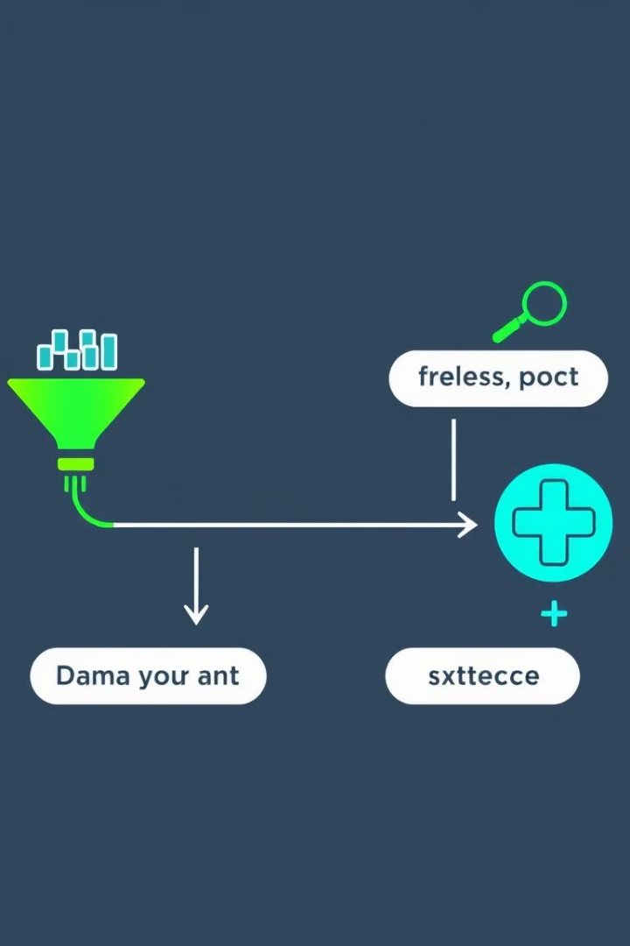
Dataset Preparation
1
Data Collection
Capture video frames using OpenCV. Extract keypoints from each frame using Mediapipe's pose, face, and hand modules. Save keypoints as .npy files organized by action, sequence, and frame.
2
Keypoint Normalization
Normalize keypoints based on image dimensions to ensure consistency across resolutions. This improves the model's robustness to variations in input data.
3
Sequence Length
Each action is represented as a sequence of 30 frames. This ensures temporal consistency and captures dynamic motion effectively.
4
Data Augmentation
Introduce variations in the dataset to enhance model generalization, such as flipping frames horizontally, adding noise to keypoints, and simulating different lighting conditions.

Slide 4



Model Architecture
Input Layer
1
Shape: (sequence\_length, 1662) (30 frames, 1662 keypoints per frame).
Hidden Layers
2
Three LSTM layers with 512, 256, and 128 units, respectively. Dropout layers to reduce overfitting. Dense layers for feature extraction.
Output Layer
3
Softmax activation for multi-class classification.

Slide 5
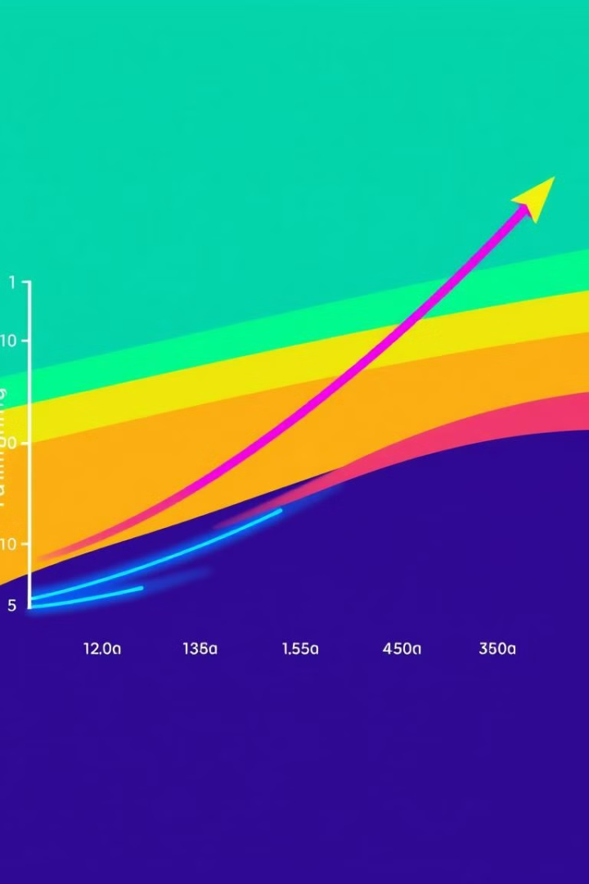
Training Process
1
Hyperparameters
2
Callbacks
Epochs: 2000, Batch Size: 32, Validation Split: 5%
TensorBoard for visualizing training metrics. EarlyStopping to stop training when validation loss stagnates. LearningRateScheduler to reduce learning rate after 10 epochs.
3
Training Results
Final Training Accuracy: ~98%, Validation Accuracy: ~95%.

Slide 6
Evaluation and Error Analysis
Evaluation Metrics
Evaluation Outcomes
Confusion Matrix: Provides detailed performance analysis for each class.
Accuracy: 95%.
Misclassified Examples: Minimal.
Accuracy Score: Overall accuracy of the model.

Slide 7
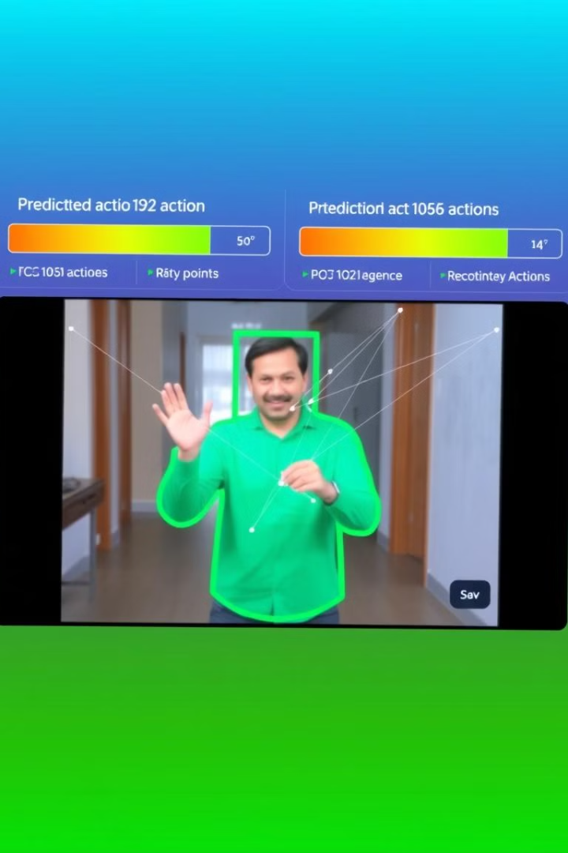


Live Predictions
Run the Script
Key Parameters
python live\_prediction.py
Sequence Length: 30 frames, Confidence Threshold: 70%.
Integration
Extend the system to interface with external applications using REST APIs or WebSocket for real-time communication.

Slide 8

Future Improvements
Expand Dataset
Optimize Model
Collect more diverse actions to improve generalization.
Reduce inference time for real-time applications.
Integration
Deploy as a web or mobile application for wider usability.

